Slide 1
Latent Heat

Slide 2
If we boil water, we will find that once it reaches 100° it does not instantaneously vaporize
Rather, It says at 100 °, and we need to keep applying energy to get it to change state.
The temperature of the liquid water we have at this stage stays constant, but we find the mass of the liquid water will decrease at it changes into steam.

Slide 3
The energy we are continuing to add to the system is not increasing the temperature at this stage, Instead it is breaking the bonds between the molecules; Converting the potential energy between the water molecules into kinetic energy.
As we know from the kinetic particle theory, As we decrease the potential energy between the particles, we increase the kinetic energy.

Slide 4
Latent Heat of vaporisation
The amount of energy that must be added to a liquid substance, to transform a quantity of that substance into a gas is known as the latent heat of vaporization.

Slide 5
Latent heat of fusion
Similar to the previous example, if we are applying heat to a block of ice to turn it into liquid water, once it reaches 0°C, it will cease increasing its temperature until it has liquified.
The energy applied to change this state is called the latent heat of fusion.

Slide 6
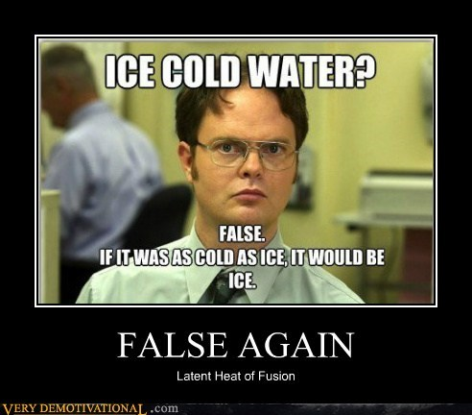

Slide 7
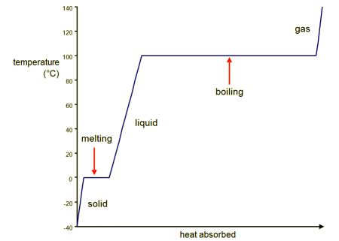

Slide 8
Q=mL
Q= energy
m= mass in kg
L= Latent heat (of fusion OR vaporisation)

Slide 9
Note: Latent heat works both ways.
The latent heat of vaporisation is the energy required to turn an amount of liquid into a gas OR the amount of thermal energy lost by a gas as it turns into liquid.
The Latent heat of fusion is the amount of energy to turn a solid into liquid OR the amount of thermal energy lost by a liquid as it solidifies.

Slide 10


